Slide 1
Millimeter-Wave Full Duplex Radios
Vaibhav Singh, Susnata Mondal, Akshay Gadre, Milind Srivastava,
Jeyanandh Paramesh, Swarun Kumar

Slide 3
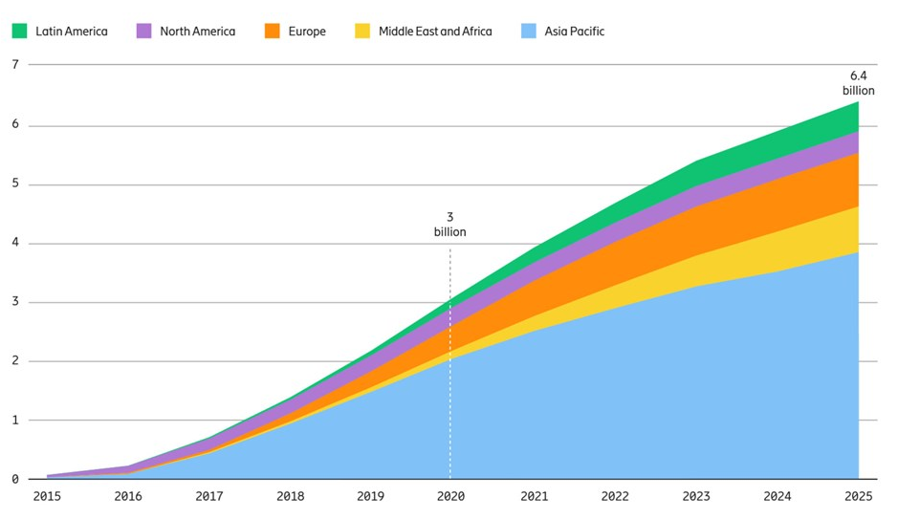
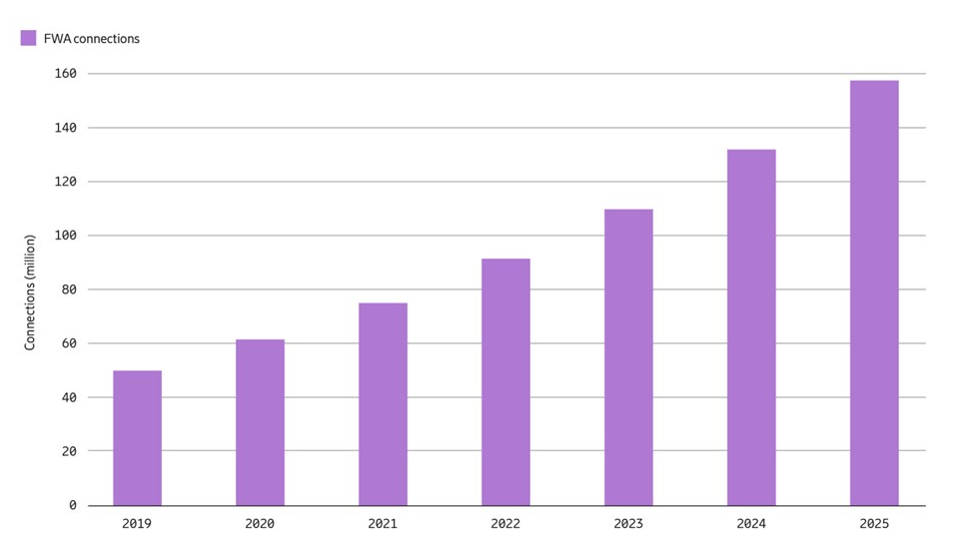
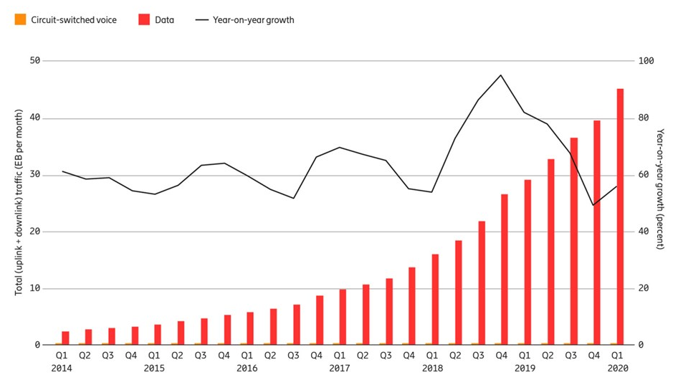
Increase by 50% every year
Mobile network traffic

Slide 4
300 KHz
3 MHz
30 MHz
300 MHz
3 GHz
30 GHz
300 GHz
Full Duplex Communication!
300 KHz
3 MHz
30 MHz
300 MHz
3 GHz
30 GHz
300 GHz

Slide 5
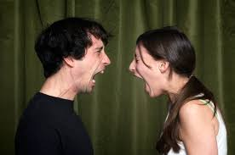

Slide 6
Power
Power
Time
Time
TX
TX
t₂
RX
t₁
RX
t₁
f₁
f₂
f₁
Frequency
Frequency
Frequency Division Duplex
Time Division Duplex

Slide 7
Power
Power
Time
Time
Power
TX
TX
Time
t₂
RX
t₁
RX
TX
t₁
~2X increase in throughput !!
RX
t₁
f₁
f₂
f₁
Frequency
Frequency
Frequency Division Duplex
f₁
Time Division Duplex
Frequency
Full Duplex

Slide 8
10-100 million times more powerful!
TX 1
RX 2
Self Interference
RX 1
TX 2

Slide 9
10-100 million times more powerful!
TX 1
RX 2
Self Interference
|H|
H_{SI}
|H_{SI}|
TX
RX
RX 1
TX 2
frequency

Slide 10
Chen. et al
Bharadia. et al
Ginzberg. et al
300 MHz
900 MHz
2.45 GHz
5 GHz
30 GHz
300 GHz

Slide 11
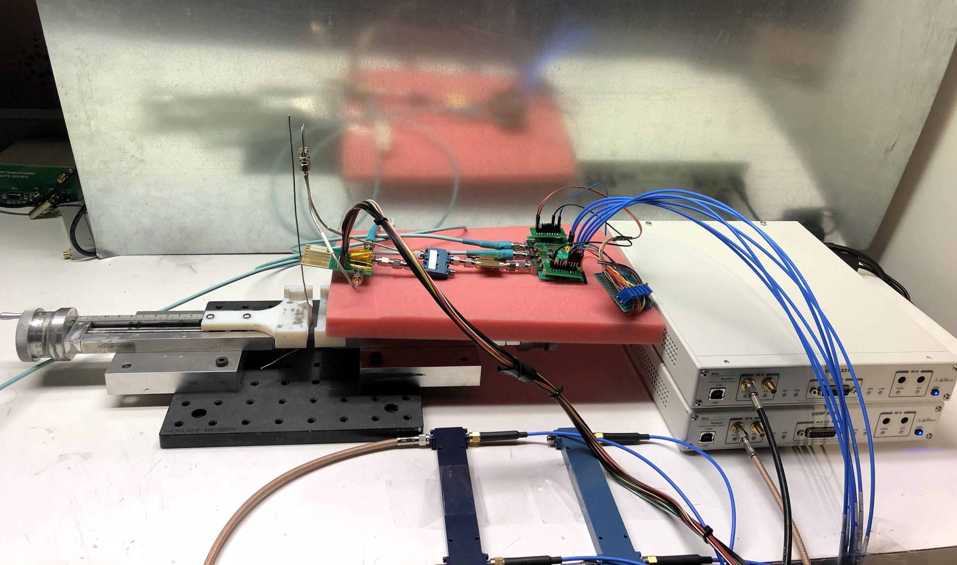
Chen. et al
Bharadia. et al
Ginzberg. et al
mmFD: the first bidirectional mm-wave full duplex link
300 MHz
900 MHz
2.45 GHz
5 GHz
30 GHz
300 GHz

Slide 12
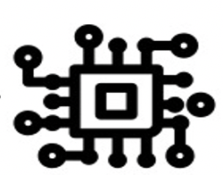
Half Duplex
Full Duplex
Desired Signal
Desired Signal
Self Interference
TX
RX
Need to simultaneously transmit, receive and cancel self interference !

Slide 13
Full Duplex Problem: in terms of numbers...
Desired Signal
Self Interference
Power (dBm)
TX Self Interference
Desired Signal
0
Noise Figure
Time
Noise Floor
60 dB ~ 10⁶ !!!
TX
RX
-60
t₁
-80
-90
f₁
Frequency

Slide 14
Full Duplex Problem: in terms of numbers...
Desired Signal
Self Interference
Power (dBm)
TX Self Interference
Desired Signal
0
Noise Figure
Time
Noise Floor
ADC range
TX
RX
-60
t₁
ADC range: max – min powers that can be sampled
-80
-90
f₁
Frequency
Cancel everything at Digital

Slide 15
Full Duplex Problem: in terms of numbers...
Desired Signal
Self Interference
Power (dBm)
TX Self Interference
Desired Signal
0
Antenna and Analog Cancellation
Noise Figure
Time
Noise Floor
TX
RX
ADC range
Cancel some at antenna and analog
-60
Digital Cancellation
t₁
-80
-90
f₁
Frequency
Cancel remaining at Digital

Slide 16
Antenna Cancellation
Self Interference
TX
H_{SI}
RX
Challenge: Estimate the Self Interference Channel coefficient H_{SI}

Slide 17
Antenna Cancellation
H_{SI} e^{i2πft}
Self Interference
Self Interference
TX
RX
Reflected Signal
negative copy
Self Reflector
Resultant

Slide 18
Antenna Cancellation
Self Interference
Self Interference
TX
d
RX
Reflected Signal
l
Self Reflector
Resultant
Find appropriate position of self reflector l !

Slide 19
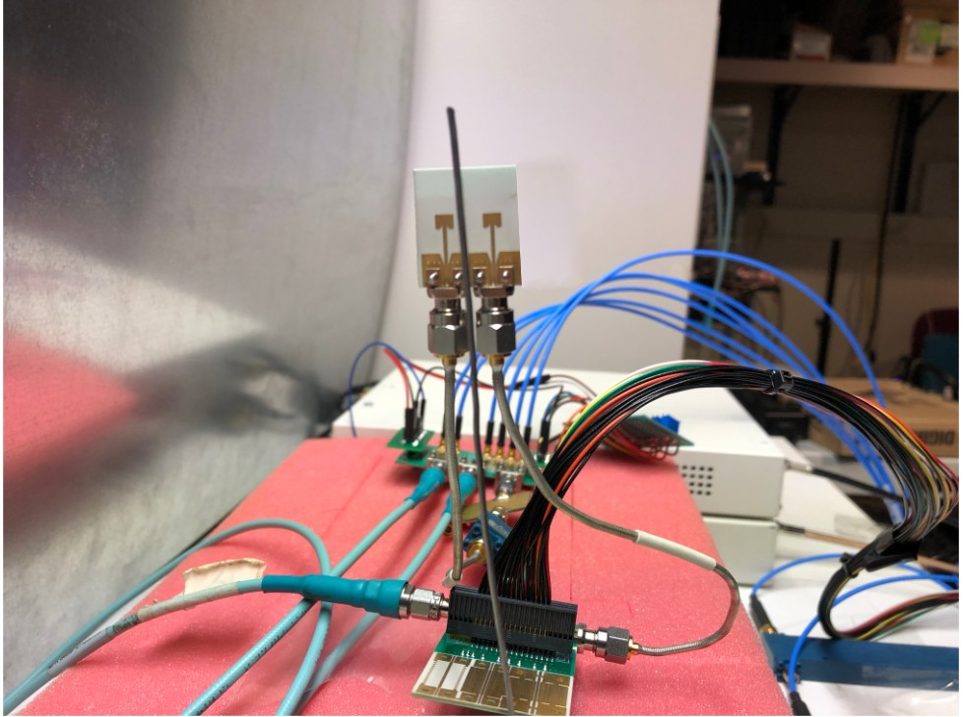
Antenna Cancellation
Self Interference
Self Reflector
TX
d
RX
Patch antenna
l
Self Reflector

Slide 20
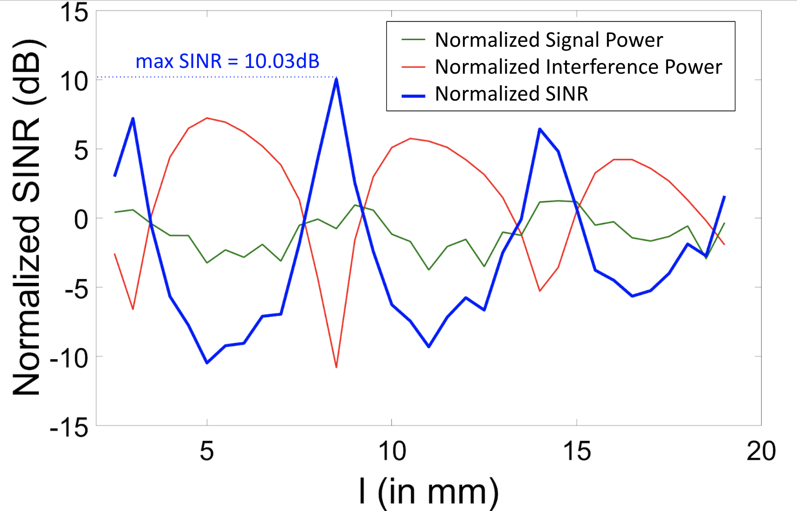
Antenna Cancellation
Self Interference
TX
d
RX
l
Self Reflector
For any value of angle(H_{SI} ), there exists an l < 1 cm

Slide 21
Antenna Cancellation
Self Interference
Self Interference
TX
RX
TX
RX
d
d
Sub 6 GHz
l
Self Reflector
l ~ 10-15 cm
Not suitable for sub-6 GHz frequencies !
Self Reflector

Slide 22
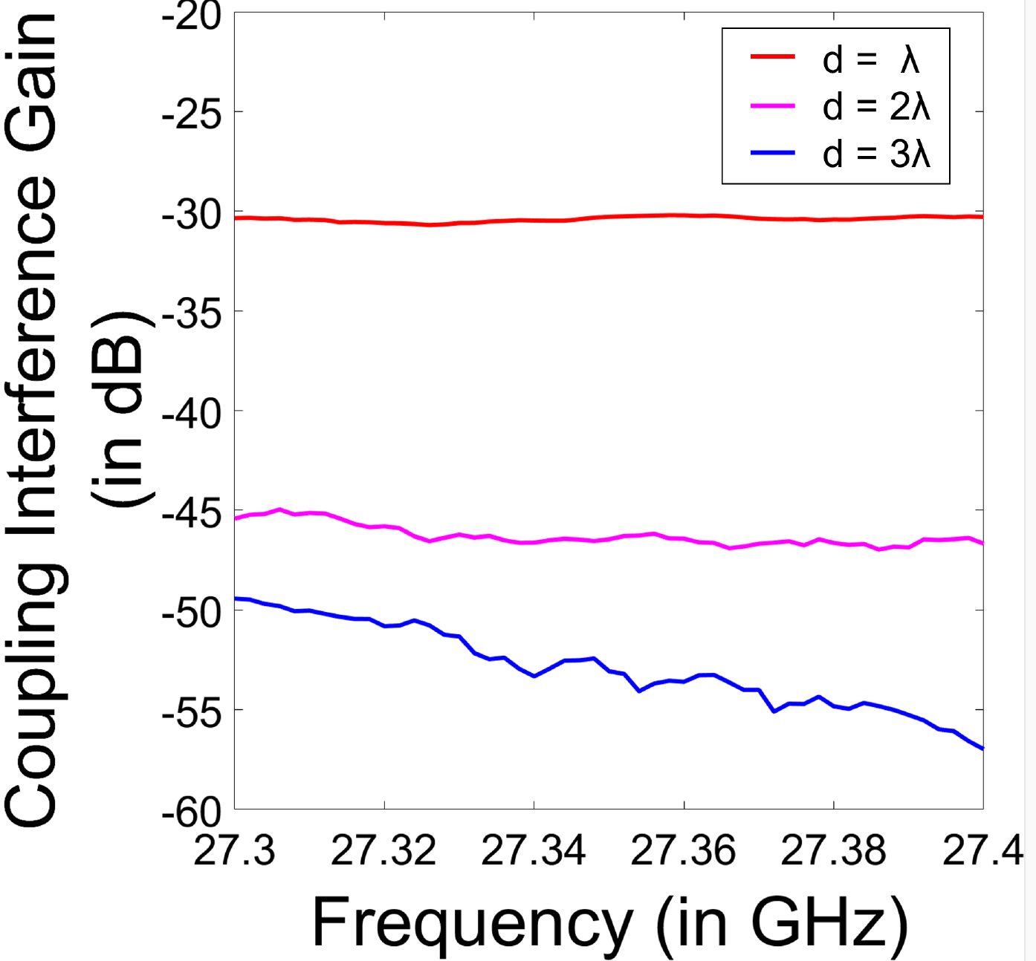
Antenna Cancellation
Self Interference
TX
RX
d
30 dB ( Antenna Coupling Loss) + 10 dB ( Self Reflector Cancellation )

Slide 23
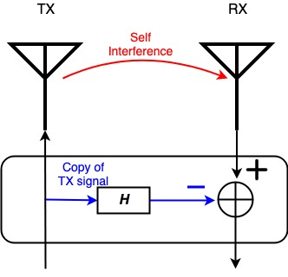
Analog Cancellation
Self Interference
TX
RX
H_{SI-RES}

Slide 24
Analog Cancellation
H_{SI-RES}
Y_{RX-SI-RES}
Copy of TX Signal
H
Y_{RX-SI-RES} = H_{SI-RES}* X_{TX}
X_{TX}
Challenge: Estimate the Residual Self Interference Channel coefficient H_{SI-RES}

Slide 25
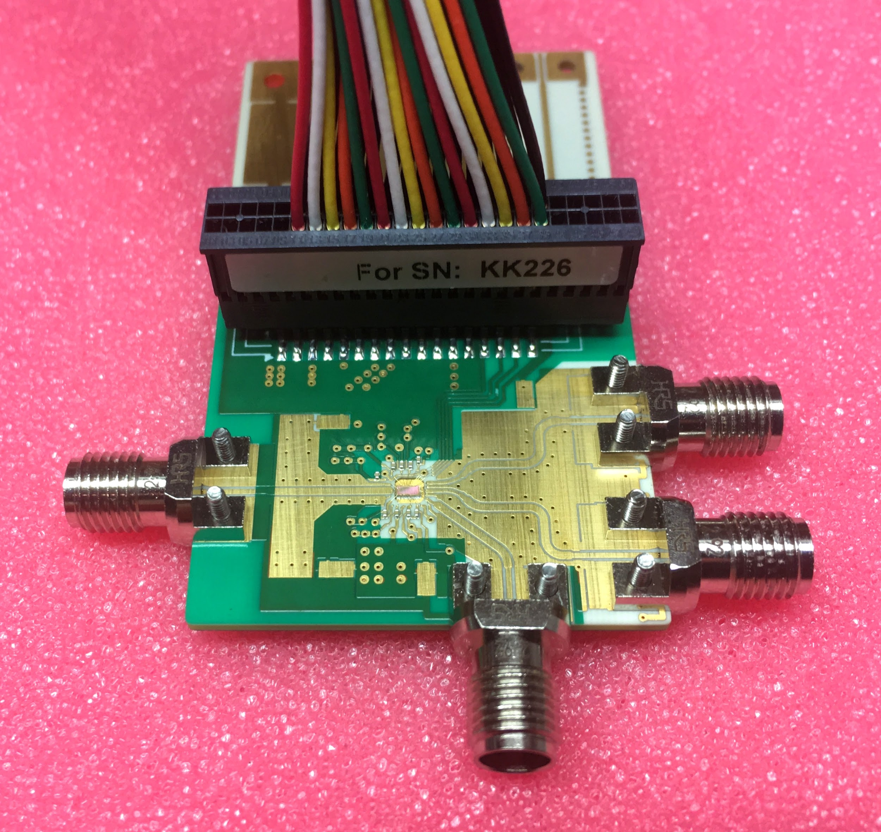
Analog Cancellation

Slide 26
Analog Cancellation
H_{SI-RES}
Modify Weight H
Set Weight H
Copy of TX Signal
H
Find residual
Training sequence
Iterative Process!

Slide 27
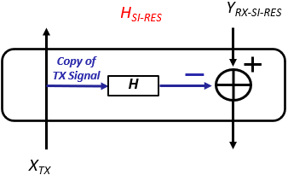
Analog Cancellation
90
Self Interference channel
Negative Desired Weight H
Desired Weight H
Current Negative Weight H
W_{CI} + iW_{CQ}
⍬_{F}
G_{F}
180
0
coarse
fine
Average analog cancellation of 18 dB
360

Slide 28
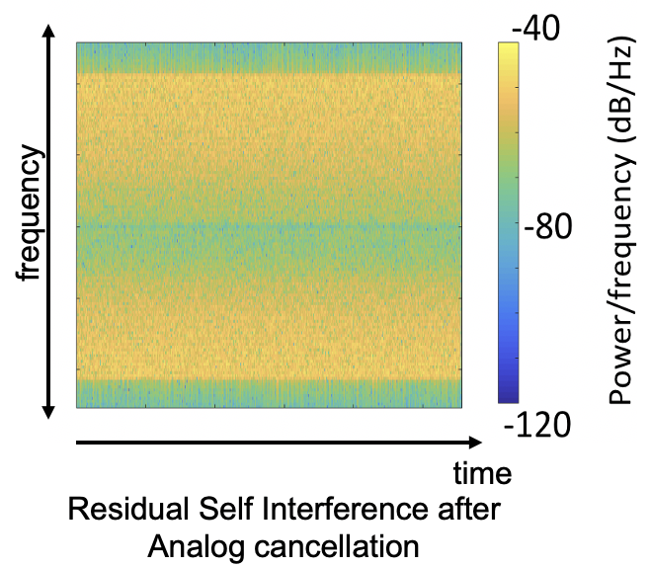
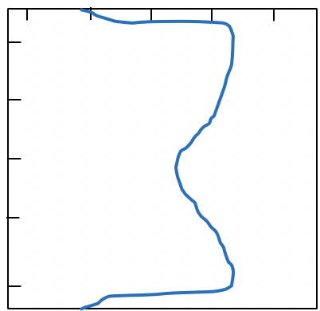
Digital Cancellation
|H|
Narrowband extension
Frequency
Frequency Selective Residual Self Interference Channel

Slide 29
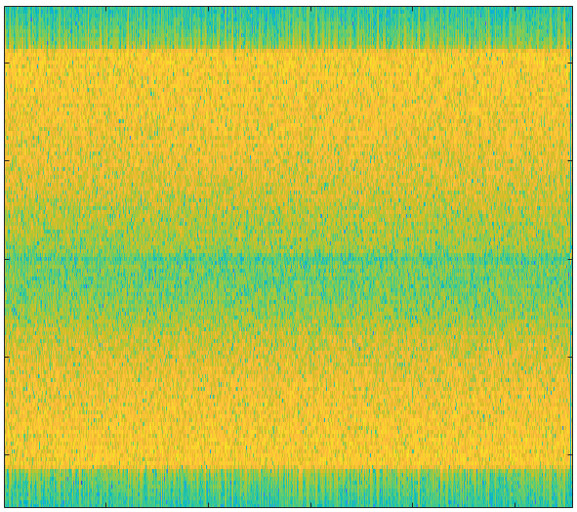
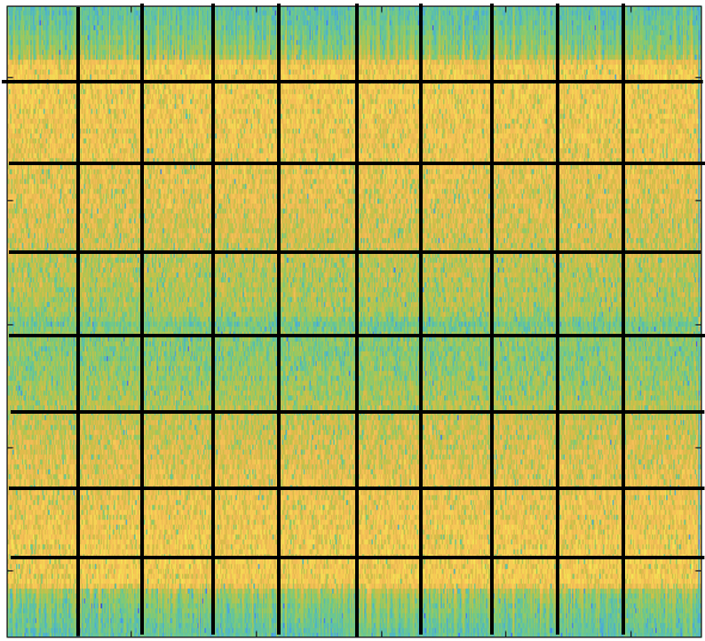
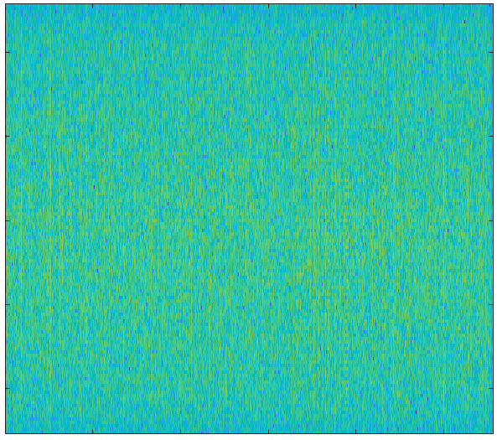
Digital Cancellation: Linear cancellation
Transmit signal chunk
Transmit signal
time
-40
Equalizer Weight
frequency
-80
Power/frequency (dB/Hz)
-120
After removing linear components
Robust to Frequency Selective behavior

Slide 30
Digital Cancellation: Non-linear cancellation
After removing linear components
After removing time invariant distortions
26 dB average Digital Cancellation

Slide 31
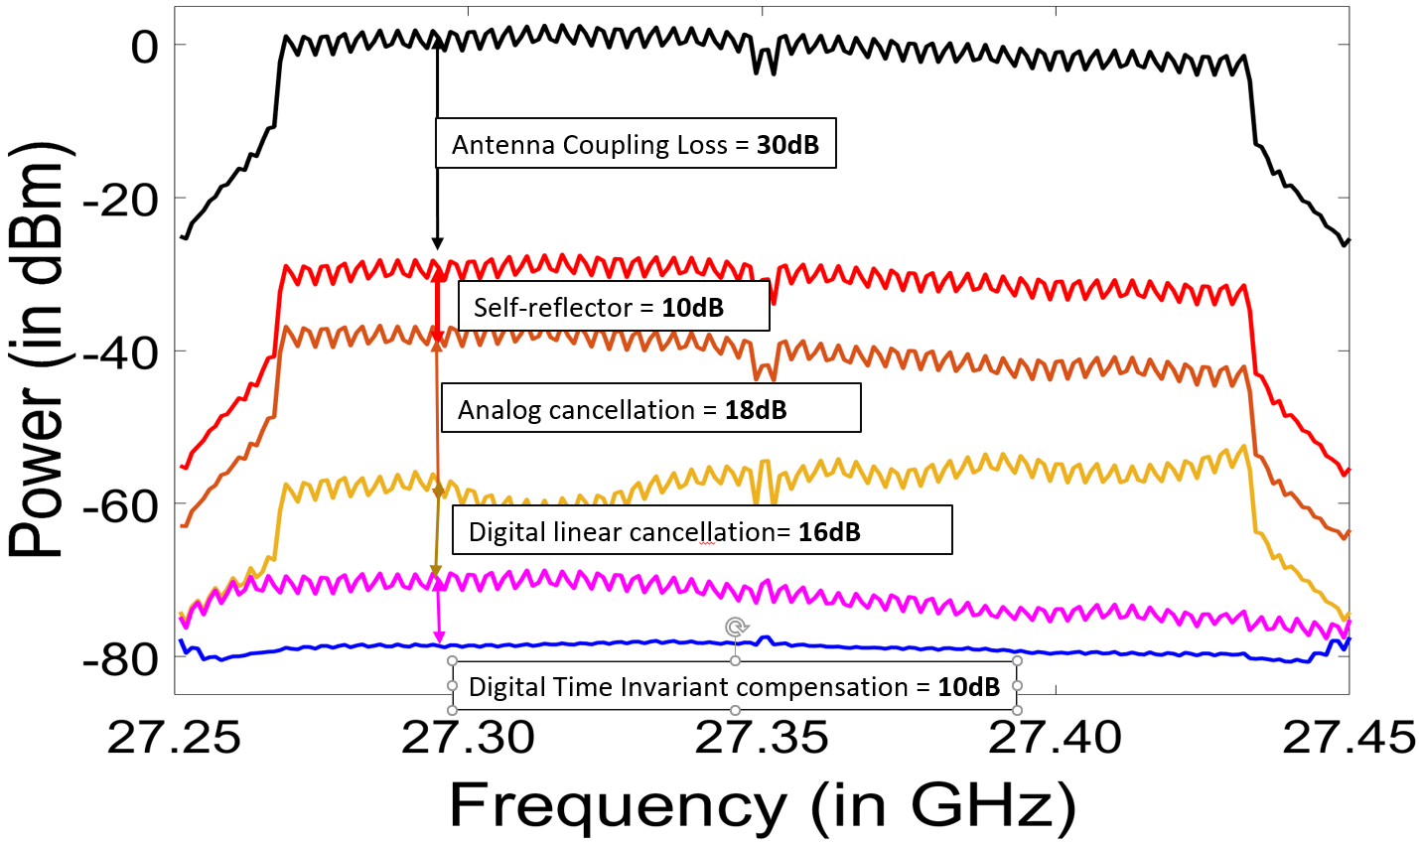
Aggregate Cancellation
Component | Interference Cancellation
Antenna Isolation | 30 dB
Self Reflector | 10 dB
Analog Cancellation | 18 dB
Digital Cancellation | 26 dB
Total Cancellation | 84 dB
84 dB average total Cancellation

Slide 32
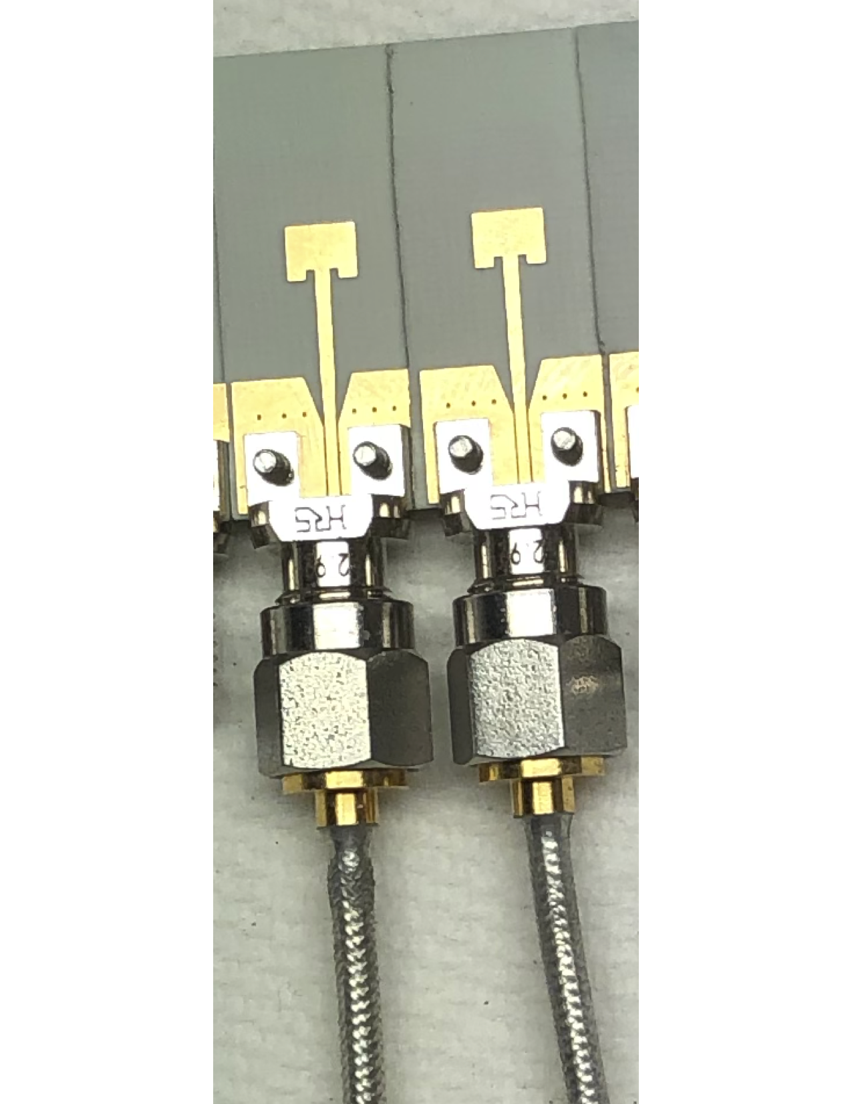
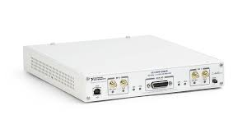
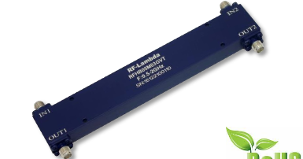
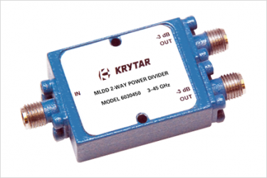
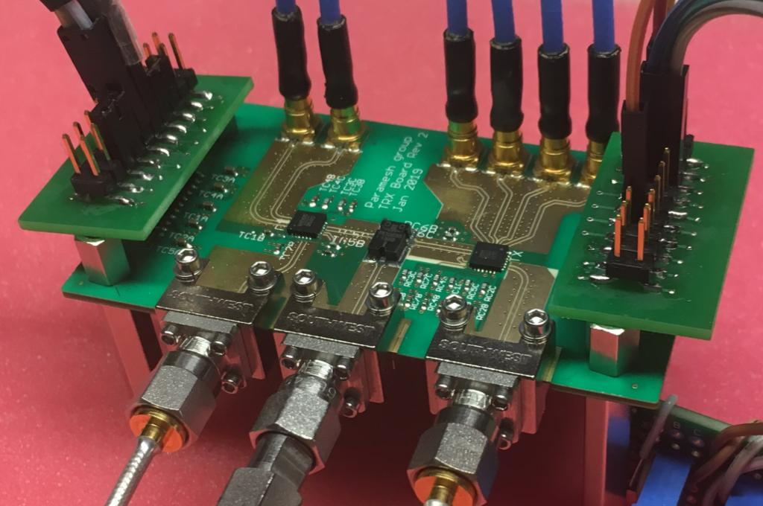
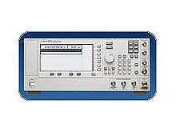
Experimental Setup
TRX board (upconversion/
downconversion to 28 GHz)
90° phase Hybrid
USRP X310 TX
Patch Antenna
Power splitter
I
TX
Q
TX copy
RX
Intermediate RF signal at 1 GHZ
I
RX post SIC
Q
FD chip
USRP X310 RX
28 GHz LO from
Agilent 8251 20-GHz PSG
mmFD Node Setup

Slide 33
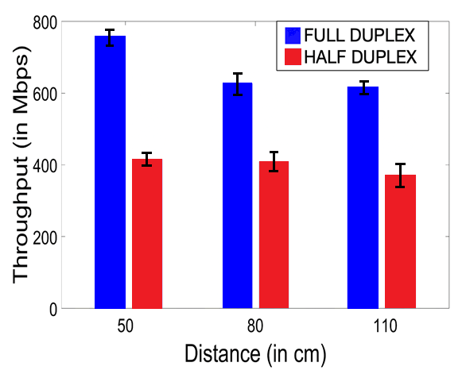
Result 1: Bidirectional Throughput
1.7X average increase in throughput

Slide 34
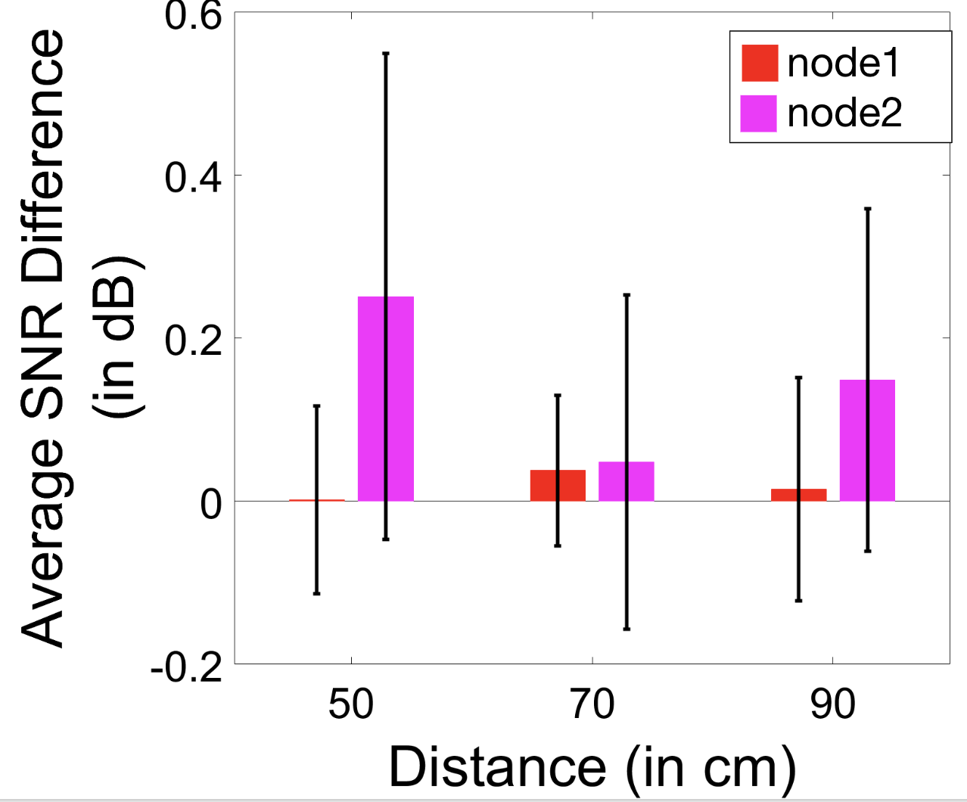
Result 2 : Bidirectional Residual Interference
50
80
110
Average Residual Self interference < 1 dB

Slide 35
Millimeter-Wave Full Duplex Radios
First Bi-directional mmWave Full Duplex Link at 28 GHz
Achieves ~84 dB self average self interference cancellation
1.7X increase in throughput compared to HD systems
https://www.witechlab.com/mmfd.html

