Slide 1
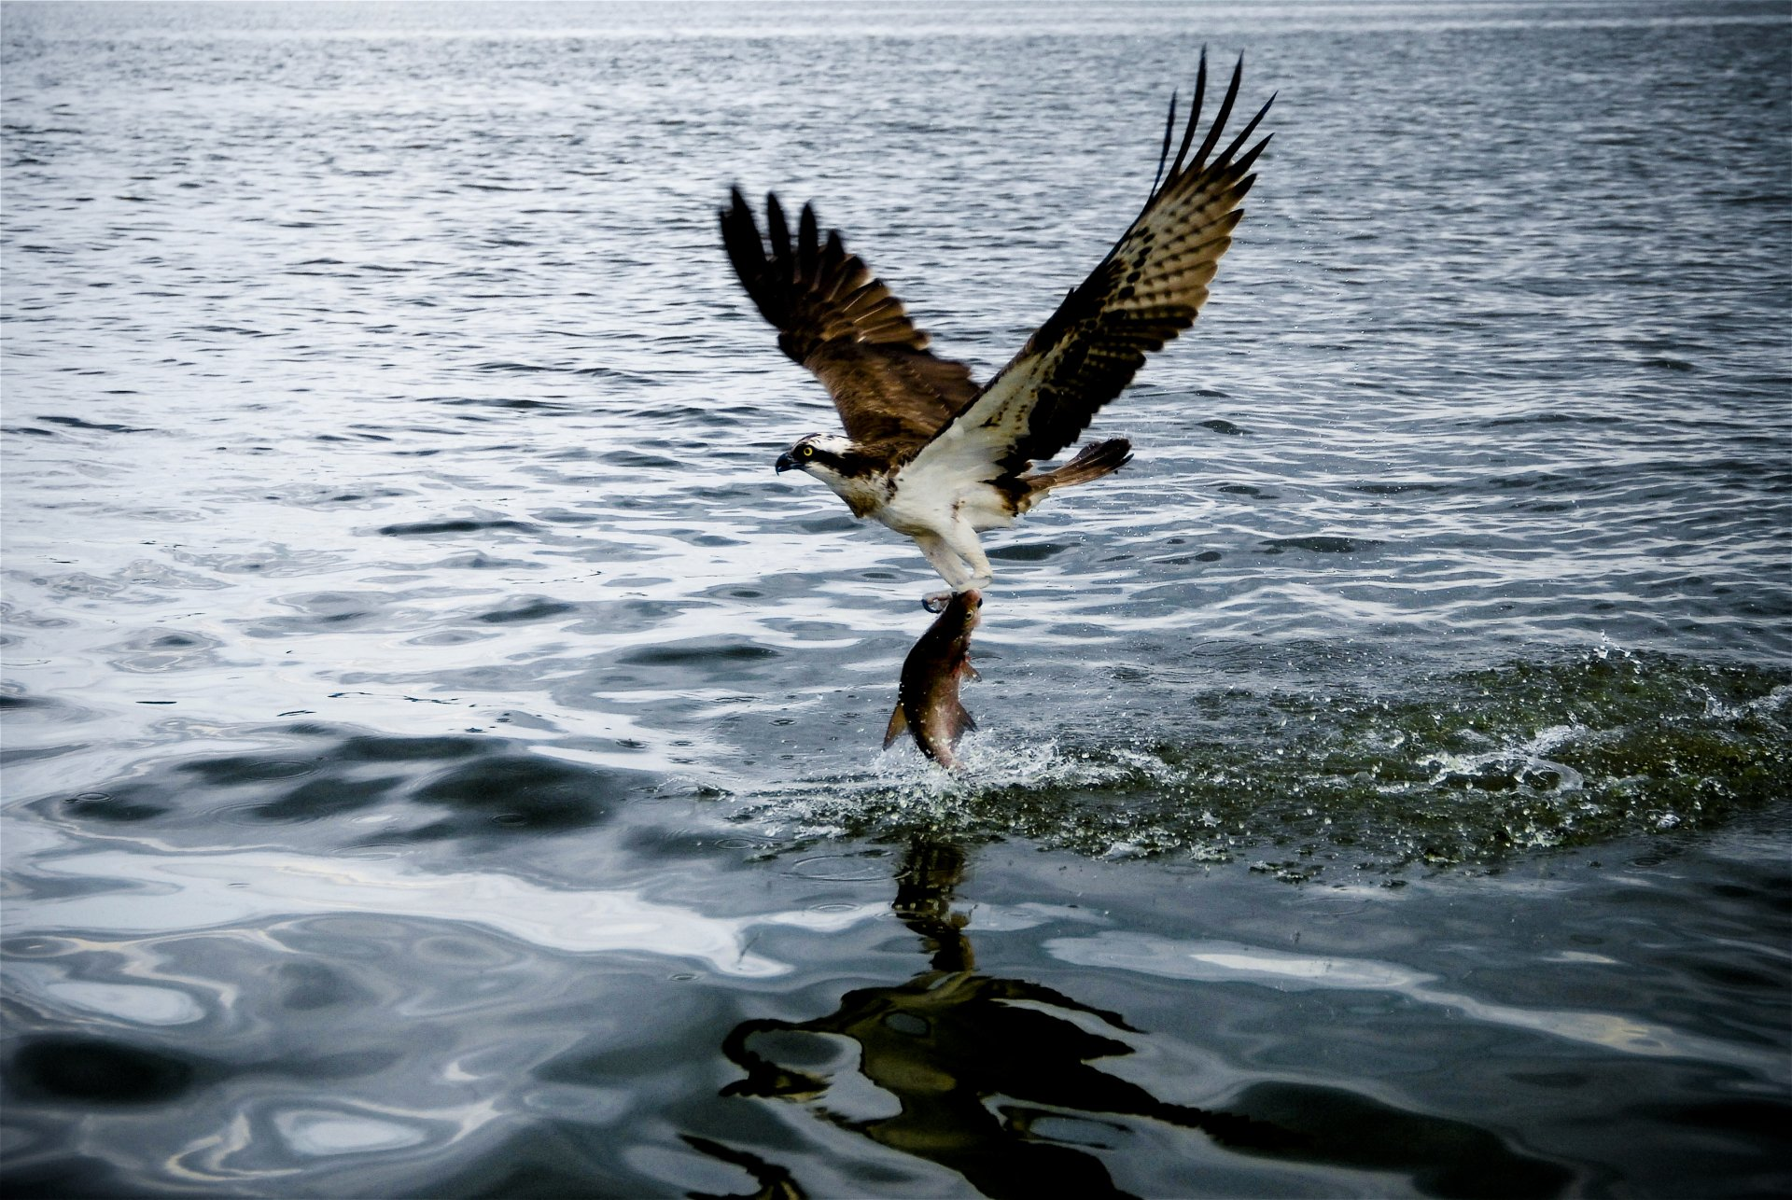
Osprey
A mmWave Approach to
Tire Wear Sensing
Akarsh Prabhakara, Vaibhav Singh,
Swarun Kumar, Anthony Rowe
ACM MobiSys 2020
Source: http://wall.alphacoders.com

Slide 3
TIRE HEALTH

Slide 4
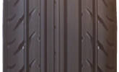

Slide 5
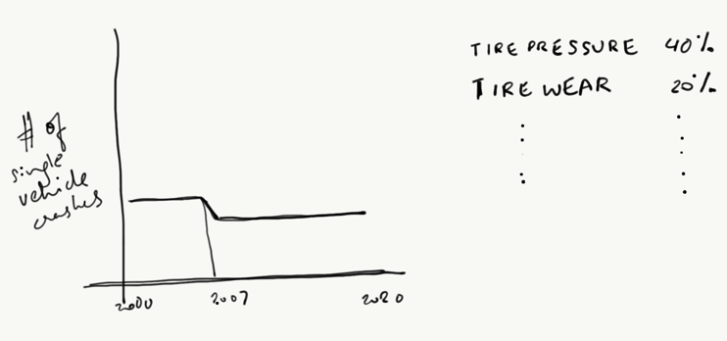

Slide 6
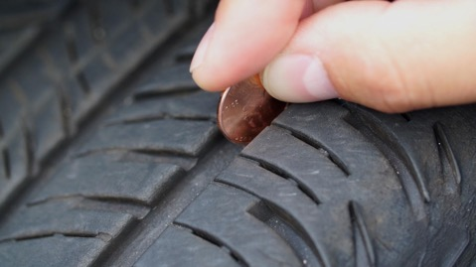

Slide 7
PERFORMANCE EFFICIENCY
SAFETY
GOAL: Design a sensor which measures tire wear

Slide 8
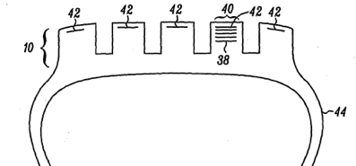
Source: US20060208902A1
CONVENIENT
FREE OF ELECTRONICS EMBEDDED IN TIRE
GOAL: Design a sensor which measures tire wear
ACCURATE
CONVENIENT
FREE OF ELECTRONICS IN TIRE
ROBUST TO DEBRIS
ACCURATE
ROBUST TO DEBRIS

Slide 9
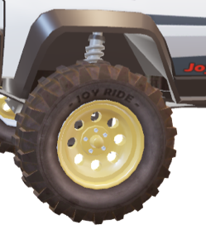
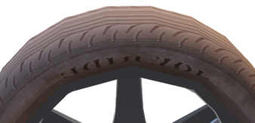
CONVENIENT
ACCURATE
FREE OF ELECTRONICS IN TIRE
ROBUST TO DEBRIS

Slide 10
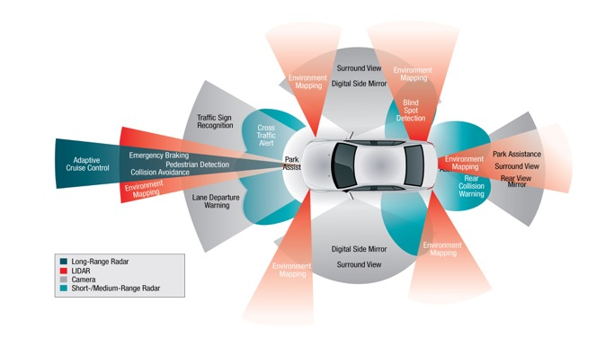
Source: https://www.insightsonindia.com/2016/11/30/insights-issues-autonomous-vehicle-technology/

Slide 11
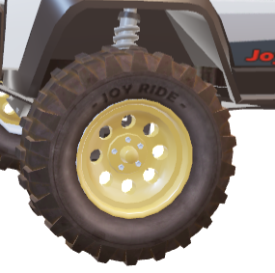
d_{surface}
d_{groove}
OSPREY
A mmWave Tire Wear Solution
Tire Wear / Tread Depth = d_{groove} - d_{surface}

Slide 12
Challenges
Tread Depth Range
2 mm to 20 mm
d_{surface}
d_{groove}
Debris
Insufficient resolution
Debris resilience

Slide 13
Challenges
Tread Depth Range
2 mm to 20 mm
d_{surface}
d_{groove}
Debris
Insufficient resolution
Debris resilience

Slide 14
DOPPLER
RESOLUTION
$$∝ \frac{1}{\text{Integration} \text{Time}}$$
RANGE
RESOLUTION
$$=\frac{c\text{τ}}{2}=\frac{c}{2B}$$
AZIMUTH
RESOLUTION
$$∝ \frac{1}{\text{Antenna} Aperture}$$
RSSI
RSSI
RSSI
DOPPLER
RANGE
AZIMUTH
RANGE
AZIMUTH
RSSI
𝜏
𝜏
𝜏
TIME DELAY

Slide 15
RANGE
RESOLUTION
$$=\frac{c\text{τ}}{2}=\frac{c}{2B}=3.75 cm$$
AZIMUTH
RESOLUTION
$$∝ \frac{1}{\text{Antenna} Aperture}≈15°$$
DOPPLER
RESOLUTION
$$∝ \frac{1}{\text{Integration} \text{Time}}$$
$$3.75 cm$$
$$2 mm \text{to}$$
$$20 mm$$
SURFACE
GROOVE
$$2 °$$
$$15 °$$

Slide 16
Synthetic Aperture RADAR Imaging
L
$${\vec{h}}_{N}$$
DOPPLER
RESOLUTION
$$∝ \frac{1}{\text{Integration} \text{Time}}$$
$${\vec{h}}_{3}$$
$${\vec{h}}_{2}$$
$${\vec{h}}_{1}$$
$$r_{N}$$
$$r_{2}$$
$$r_{1}$$

Slide 17
Inverse Synthetic Aperture RADAR Imaging
DOPPLER
RESOLUTION
$$∝ \frac{1}{\text{Integration} \text{Time}}$$
FIELD OF VIEW
$${\vec{h}}_{2}$$
$${\vec{h}}_{3}$$
$${\vec{h}}_{1}$$
$${\vec{h}}_{N}$$

Slide 18
Y
Z
DOPPLER
RESOLUTION
$$∝ \frac{1}{\text{Integration} \text{Time}}$$
$$(D,0, 0)$$
$$(r, ∅, z)$$
$$(D,0, 0)$$
$$∅$$
X
$$z$$
X
r
$$(r, ∅, z)$$
$$D$$
$$D$$

Slide 19
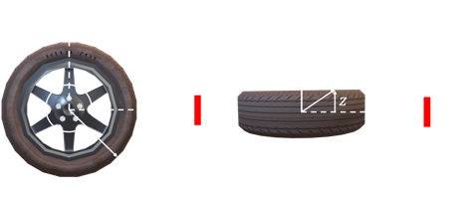
${\vec{h}}_{1}=e^{j\frac{4πd_{A}(1)}{λ}}$ $e^{j2πf_{A}(1)n}$
Z
${\vec{h}}_{2}=e^{j\frac{4πd_{A}(2)}{λ}}$ $e^{j2πf_{A}(2)n}$
DOPPLER
RESOLUTION
$$∝ \frac{1}{\text{Integration} \text{Time}}$$
Rich phase
information
Traditional
ranging
$${\vec{h}}_{N}$$
$${\vec{h}}_{2}$$
$${\vec{h}}_{1}$$
$$A (r_{A},∅_{A}, z_{A})$$
$$H_{A}$$
$$d_{A}(t)$$
X
$$1$$
$$(D,0, 0)$$
$$N$$

Slide 20
Z
$$H_{A}$$
DOPPLER
RESOLUTION
$$∝ \frac{1}{\text{Integration} \text{Time}}$$
$$A$$
$$1$$
$$N$$
$$B$$
$$C$$
$$D$$
$$…$$
$$H_{recv}=H_{A}+H_{B}+ …+noise$$
X
$$(D,0, 0)$$

Slide 21
Z
$$H_{temp,i}$$
DOPPLER
RESOLUTION
$$∝ \frac{1}{\text{Integration} \text{Time}}$$
$$i$$
$${\vec{h}}_{2}$$
$${\vec{h}}_{1}$$
$$1$$
$$N$$
${\vec{h}}_{1}=e^{j\frac{4πd_{i}(1)}{λ}}$ $e^{j2πf_{i}(1)n}$
$$d_{i}(t)$$
${\vec{h}}_{2}=e^{j\frac{4πd_{i}(2)}{λ}}$ $e^{j2πf_{i}(2)n}$
X
$$(D,0, 0)$$

Slide 22
Z
$$1$$
$$N$$
$$1$$
$$N$$
$$H_{recv}$$
$$H_{temp,i}$$
DOPPLER
RESOLUTION
$$∝ \frac{1}{\text{Integration} \text{Time}}$$
$$i$$
$$A$$
$$H_{recv}$$
$$B$$
$$C$$
$$H_{temp,i}$$
$$D$$
$$…$$
X
$$(D,0, 0)$$

Slide 23
Z
$$P\left(r_{i},∅_{i},z_{i}\right)$$
=
DOPPLER
RESOLUTION
$$∝ \frac{1}{\text{Integration} \text{Time}}$$
$$i$$
*
(
)
$$A$$
$$∑∑$$
$$⊙$$
$$B$$
$$C$$
$$D$$
$$1$$
$$N$$
$$1$$
$$N$$
$$…$$
$$H_{temp,i}$$
$$H_{recv}$$
X
$$(D,0, 0)$$

Slide 24
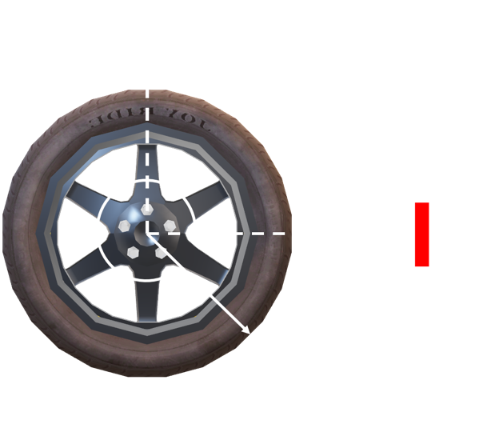
Tire Wear with ISAR Imaging
DOPPLER
RESOLUTION
$$∝ \frac{1}{\text{Integration} \text{Time}}$$
$$r_{\text{groove}}$$
$$r_{\text{surface}}$$

Slide 25
Z
DOPPLER
RESOLUTION
$$∝ \frac{1}{\text{Integration} \text{Time}}$$
X
$$(D,0, 0)$$

Slide 26
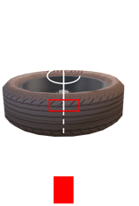
DOPPLER
RESOLUTION
$$∝ \frac{1}{\text{Integration} \text{Time}}$$
Tire Tread Patterns
$$z$$
ISAR Image
$$r$$
$$r_{\text{surface}}$$
Azimuth $∅$

Slide 27
Z
DOPPLER
RESOLUTION
$$∝ \frac{1}{\text{Integration} \text{Time}}$$
Featureless groove
$$r_{\text{groove}}$$
X
$$(D,0, 0)$$

Slide 28
Challenges
Tread Depth Range
2 mm to 20 mm
d_{surface}
d_{groove}
Debris
Insufficient resolution
Debris resilience

Slide 29
Z
DOPPLER
RESOLUTION
$$∝ \frac{1}{\text{Integration} \text{Time}}$$
Feature rich groove
X
$$(D,0, 0)$$

Slide 30
Z
DOPPLER
RESOLUTION
$$∝ \frac{1}{\text{Integration} \text{Time}}$$
RSSI
Feature rich groove
Debris
RANGE
X
$$(D,0, 0)$$

Slide 31
x${10}^{6}$
3
2.5
DOPPLER
RESOLUTION
$$∝ \frac{1}{\text{Integration} \text{Time}}$$
2
RSSI (linear)
1.5
1
0.5
Aluminium
Paper
Rubber
Cloth
Plastic
Cardboard
Materials

Slide 32
Z
Encoding a pattern
DOPPLER
RESOLUTION
$$∝ \frac{1}{\text{Integration} \text{Time}}$$
RSSI
Aluminium strips in groove
Debris
0
1
1
1
0
0
1
0
1
1
0
RANGE
X
$$(D,0, 0)$$

Slide 33
Z
DOPPLER
RESOLUTION
$$∝ \frac{1}{\text{Integration} \text{Time}}$$
Aluminium strips in groove
in coded patterns
0
1
--- - - --- --- - --- - - --- -
1
1
0
1
1
0
0
1
0
Debris
X
$$(D,0, 0)$$

Slide 34
$$P\left(r\right)$$
=
Z
*
(
$$⊙$$
)
$$∑∑$$
DOPPLER
RESOLUTION
$$∝ \frac{1}{\text{Integration} \text{Time}}$$
$$1$$
$$N$$
$$1$$
$$N$$
$$H_{temp,C}(r)$$
$$H_{recv}$$
0
1
--- - - --- --- - --- - - --- -
1
1
0
1
1
0
0
1
0
$$r_{\text{groove}}=\underset{ r}{arg max}{|P(r)|}$$
X
$$(D,0, 0)$$

Slide 35
Osprey Overview
Z
ISAR Imaging
DOPPLER
RESOLUTION
$$∝ \frac{1}{\text{Integration} \text{Time}}$$
$r_{\text{surface}}$
0
1
--- - - --- --- - --- - - --- -
1
1
0
1
1
0
0
1
0
$r_{\text{groove}}$
$r_{\text{surface}} −r_{\text{groove}}$
X

Slide 36
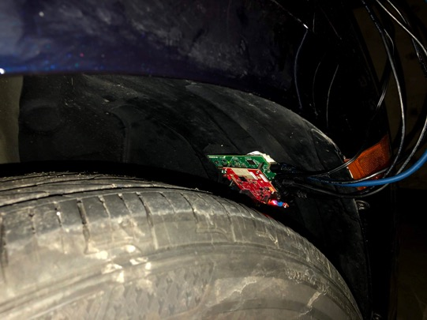
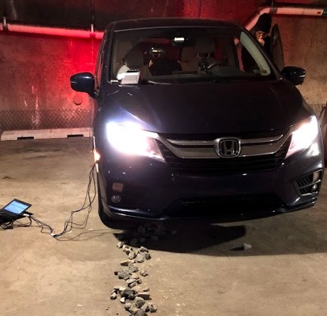
Implementation and Evaluation
DOPPLER
RESOLUTION
$$∝ \frac{1}{\text{Integration} \text{Time}}$$

Slide 37
True Tread Depth
1.7 mm
5 mm
2
1.5 mm maximum mean error
8.75 mm
DOPPLER
RESOLUTION
$$∝ \frac{1}{\text{Integration} \text{Time}}$$
1.5
Tire Wear Error
(in mm)
1
0.5
0
0.62
2.32
5.45
Speed
(in kmph)

Slide 38
Osprey
Laser
8
DOPPLER
RESOLUTION
$$∝ \frac{1}{\text{Integration} \text{Time}}$$
6
Tire Wear Error
(in mm)
4
2
1.5 mm maximum mean error
0
3 (34%)
5 (57%)
8 (91%)
Debris Level – in mm (% of tread depth covered)

Slide 39
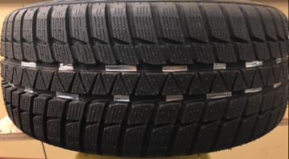
More Challenges in Full Paper
DOPPLER
RESOLUTION
$$∝ \frac{1}{\text{Integration} \text{Time}}$$
Suspension
Vibration
Misalignment
Multiple Grooves
Foreign Objects

Slide 40
OSPREY
A mmWave Tire Wear Solution
DOPPLER
RESOLUTION
$$∝ \frac{1}{\text{Integration} \text{Time}}$$
mm Accurate
Convenient Monitoring
Free of Electronics in Tire
Robust to Debris
Find out more about our work on
witechlab.com/osprey

